Slide 1
WP2 - Data integration and exposome-phenotype associations presented by Etienne Audureau
30/09/2021

Slide 2

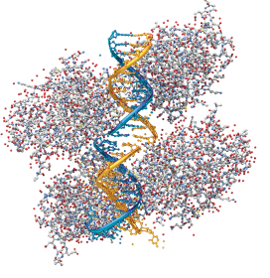
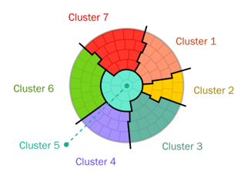
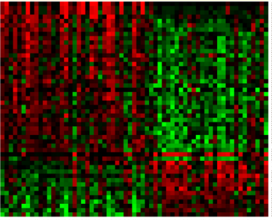

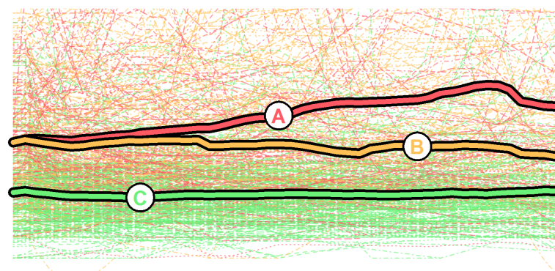
WP2 Objectives for period 1
There are four main objectives for WP2, of which the two first directly pertain to the reporting period,
while the two latter are still preparatory
S1
S2
Phenotype
S3
+
Exposome
S..
To integrate within a unified database all preexisting health and environmental data relevant to REMEDIA’s research objectives from the participating cohorts
To enrich the resulting database with public available environmental and contextual information to be matched with subjects geocoded residence and newly conducted OMICs analyses in targeted case-controls studies
To conduct descriptive analyses and unsupervised clustering approaches to characterize COPD/CF phenotypes
To explore exposome-phenotype associations through an exposome-wide association study (EWAS) approach.

Slide 3
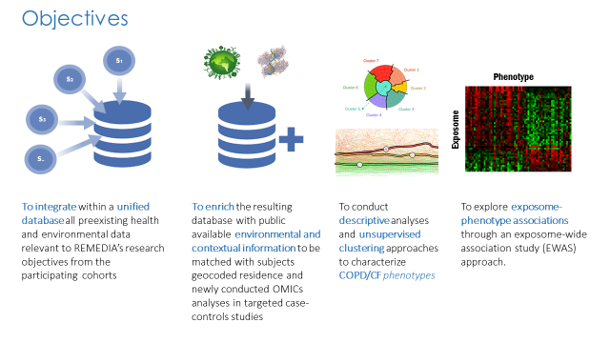



WP2 achievements
Task 2.1: Preexisting data integration (M1-M60)
Leader: P03-CHIC, Contributors: P01-INSERM, P02-LISA, P04-DCS, P12-UiT
Technical specifications and data inventory for the unified database have been determined
All the application forms to access the datasets of the pre-existing cohorts have been submitted
    DCH /Denmark registries Application form submitted in April 2021 (delays in response)
    VLM Application form submitted in April 2021
    informally authorized (data access pending)
    ALSPAC Application form submitted in August 2021 (authorization pending)
    Pelagie Authorized access to the database
    Remote access through Datashield / Athlete pending
    NOWAC / Tromsø cohort Authorizations pending
    Biological samples Depending on new partner currently sought for –omics analyses

Slide 4
WP2 achievements
Task 2.2: Exposome data enrichment (M1-M30)
Leader: P02-LISA, Contributors P01-INSERM, P03-CHIC, P04-DCS, P12-UiT.
Discussion on and data collection of environmental external exposome data have been initiated, focusing on two sources:
  in-situ data : precise but spatially sparse
  modeling data : not the most precise due to their resolution, but with a very good spatial coverage
In-situ measurement data for the following air pollutants (SO 2 , NO 2 , CO, PM 2.5 , PM 10 and Ozone) have been obtained from the archives of EEA (European Environment Agency) from year 2001 to 2020.
Modeling data will be used based on simulations (reanalysis performed using 4DVar data assimilation) produced in the Copernicus Atmosphere Monitoring Service and annual reanalysis for France carried out by INERIS (from 2000 to 2019)
Notes:
Meetings avec VLM et PELAGIE pour rajouter des infos

Slide 5
WP2 achievements
Task 2.3: Descriptive analyses and phenotypic characterization (M12-M36)
Leader: P01-INSERM, Contributors: P02-LISA, P04-DCS, P05-DMI, P12-UiT, P07 CEGX, P08 Lipotype
Statistical analyses not yet started due to delayed access to data
Statistical analysis plans and programming codes have already been drafted
  To allow a rapid initiation of the analyses as soon as the datasets are available
No change foreseen for the “end month” of this task (M36)

Slide 6
WP2
WP2 deliverables
No deliverables in period 1

Slide 7
WP2
WP2 Milestones
N° | Titel Milestone | WP | due date (DoA) | Partners | Actual / Forecast delivery date (day/month/year) | Status (achieved/ not achieved) | Comments Report 1
MS3 | Ethical and regulatory approvals achieved | 2 | 6 | P03 CHIC/P01b Inserm |  | Not yet achieved | Access to data from pre-existing cohorts has been delayed (please see Section #5 for details). A first batch is expected to be available for most clinical information from ALSPAC/VLM/DCH/Danish registries by Sep 2021
MS4 | Operational data repository ready for data hosting | 2 | 12 | P03 CHIC/P01b Inserm |  | Not yet achieved | The extent of the unified database will be determined depending on the regulatory constraints for each cohort. Final technical specifications and building of the unified database will thus be achieved when availability and conditions of use will be clearly defined for all datasets, which is expected during 2022 (first semester being the target for the achieved completion of the functional data repository).

Slide 8
WP2 - Management
Hurdles and bottlenecks
Initial delay for the initiation of the access authorizations to the cohorts due to the pandemics
A re-organization of tasks for the database building had to be made with Kaduceo incorporated within the consortium in Jan 2021
Cambridge Epigenetix (CEGX) who oversaw epigenetics analyses withdrew of the project in 2021
  A new partner is currently being sought to perform the biological analyses initially planned.
  This implies to postpone the specific application forms to access biological data
Extent of the unified database had to be limited.
  Some cohorts will only allow for distant access while other allow for data download.
Databases with no data transfer allowed: : for DCH cohort, Denmark registries, and PELAGIE cohort, remote access will be granted to listed REMEDIA researchers to perform data analyses through the preexisting technical and security framework of each database
Databases with data transfer allowed: for the CF registry VaincreLaMuco, ALSPAC cohort and, possibly the NOWAC / TROMSO cohorts (to be confirmed), databases will be gathered and integrated within the centralized REMEDIA data repository

Slide 9
WP2 - Management
Hurdles and bottlenecks
Initial delay for the initiation of the access authorizations to the cohorts due to the pandemics
A re-organization of tasks for the database building had to be made with Kaduceo incorporated within the consortium in Jan 2021
Cambridge Epigenetix (CEGX) who oversaw epigenetics analyses withdrew of the project in 2021
  A new partner is currently being sought to perform the biological analyses initially planned.
  This implies to postpone the specific application forms to access biological data
Extent of the unified database had to be limited.
  Some cohorts will only allow for distant access while other allow for data download.
Consequently, there is a raw delay of 9 months for the initiation of statistical analyses
  Since first descriptive statistical analyses from T2.3 were planned to start at M12
  While most datasets will actually be available by M21

Slide 10

WP2 - Management
Decisions/actions to be taken within the next months
Within WP2
T2.1 - Pre-existing data integration (M1-M60)
  Data inventory and technical specifications for the unified database already made
  ► Development of the REMEDIA database by Kaduceo as soon as the datasets are available
T2.2 - Exposome data enrichment (M1-M30) remains on schedule for the external exposome
  ► Decision on new partner for –omics analyses by Nov 2021
  ► Application forms to access biological samples to be sent by Dec 2021
T2.3 - Descriptive analyses and phenotypic characterization (M12-M36) unmodified end month
  Statistical analysis plans and programming codes already drafted
  ► Data scientist position currently being advertised to further support T2.3 analyses;
T2.4 - Exposome-phenotype associations (M30-48) remains on schedule

Slide 11

WP2 - Management
Decisions/actions to be taken within the next months
Outside WP2
WP4
T4.1 Generation and characterization of complex representative atmosphere(s) (M01-M36)
Not impacted, testing technical specifications for experiments on atmosphere components
T4.2 Implementation of more complex simulated external exposome (M24-M42)
T4.3 Exposure of preclinical models (naïve, COPD and Cystic Fibrosis) (M24-M60)
Aim at testing specific exposure components and/or combinations, notably based on the output from WP2
  ► Comprehensive literature review to identify key exposure combinations to be initially tested
  ► Subsequent experiments to be tailored according to upcoming results from T2.3/T2.4 analyses.
  M.P.H epidemiologist hired on September 1, 2021 for these tasks

Slide 12
WP2 - Scientific Management
Meetings organised:
Over 30 meetings organized over Period 1
  Between WP2 partners on a bimonthly basis
  Dedicated meetings with VaincreLaMuco Registry, WP4 REMEDIA
Meetings to come:
Bimonthly planned WP2 meetings for partners up to end June 2022
Dedicated meeting with Pelagie / LISA
Ongoing collaborations /connections to other WPs:
WP4 through the hiring of Pascal Baptiste

Slide 13
WP2 Outlook: Workplan period 2
M21 – M24 Literature Review
M21 – M36 Statistical analyses T2.3
Descriptive and unsupervised analyses (clustering)
  Exposome-related components to describe their potential co-occurrence in some subgroups, to identify clusters of subjects with common exposure patterns and to describe their association with lung function/disease course.
  Lung function parameters (FEV1, FVC, FEV1/FVC) to identify potential typical trajectories in lung function evolution
  Methods
    Cross-sectional analyses: hierarchical clustering, mixture models, self-organizing maps
    Longitudinal analyses: kML, kML3D algorithms as well as latent class model-based approaches
M30 – M48 Statistical analyses T2.4
Supervised analyses to identify potential predictors of lung function / disease course
  Individual components of the exposome as well as clusters of exposures potentially identified in the previous step will be assessed within predictive regression models and machine learning algorithms, following an exposome-wide association study (EWAS) framework to account for test multiplicity.

Slide 14
WP2
Other issues
Questions for advice from WP to reviewers

Slide 16
Backup slides

Slide 17

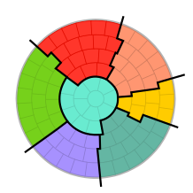
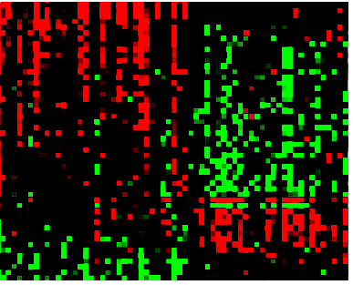
Tasks
Task 2.1
Preexisting data integration
Task 2.2
Exposome data enrichment
Task 2.3
Descriptive analyses and phenotypic characterization
Task 2.4
Exposome-phenotype associations

Slide 18
Task 2.1 Preexisting data integration
  Data sources
Cohort | Location | Name of REMEDIA PI contact | Population | Samples available | Lung Function
DCH | Denmark | Mette Sorensen | 57053 individuals between 50-65 years at enrolment in 1993-1997 | Blood samples | No
Pélagie | France | Bénédicte Jacquemin Cécile Chevrier | 3400 pregnant mothers included in 2002 and followed with their kids since | Cord blood samples at birth, 12 and 17 yo | Yes at 16
ALSPAC | UK | Sophie Lanone | 14500 families in the Bristol area | Cord blood sample, Plasma + blood (+ urine starting @ 10 yrs) | Yes, x3
CF patients’ registry | France | Ralph Epaud | 6757 children and adult with confirm CF | Blood samples | Yes, annually
NOWAC | Norway | Torkjel M Sandanger | 170,000 Norwegian women | Blood, including preserved mRNA in PAX tubes, white blood cells (buffy coat), and plasma | Yes
►CF/ COPD patients and subjects at various times of life with lung function evaluation

Slide 19
Objectives and study populations
Cohorts
DCH
NOWAC
ALSPAC
PELAGIE
CF Registry
Targeted case-control studies: subgroups of interest
Incident COPD (N=100)
Estimated 2-3k [DCH]
Controls (N=100)
x3 lung function (8-15-24y)
x1 lung function (16y)
Strict matching by
Age, gender, smoking
Smokers (50%)
Non Smokers (50%)
Normal +/-altered lung functions w/o COPD
Exposure characterization on large populations
Overall population
Exposome-related clusters
Overall population
Exposome-related clusters
COPD
Exposome-related
risk factors and prognostic factors
Lung function status and trajectories
CF
Exposome-related
prognostic factors

Slide 20
Exploring the exposome
The exposome is constituted of three overlapping domains:
a general external environment including factors such as the urban environment, climate factors, social capital, stress;
a speciﬁc external environment including speciﬁc contaminants, diet, physical activity, tobacco, and
an internal environment including internal biological factors such as metabolism, gut micro ﬂora, inﬂammation, and oxidative stress.
Complex diseases are multifactorial and caused by multiple genetic and environmental factors operating additively or in concert. Yet, most epidemiological studies consider only a handful exposures at a time
Different statistical approaches needed
To describe exposure mixtures and exposome patterns (as most normally encountered in reality)
To identify the most important exposures with respect to adverse health effects (crucial for regulatory policy)
To identify synergistic or interactive effects
Agier et al. Early-life exposome and lung function in children in Europe: an analysis of data from the longitudinal, population-based HELIX cohort.
Lancet Planet Health 2019; 3: e81–92
Notes:
HELIX

Slide 21
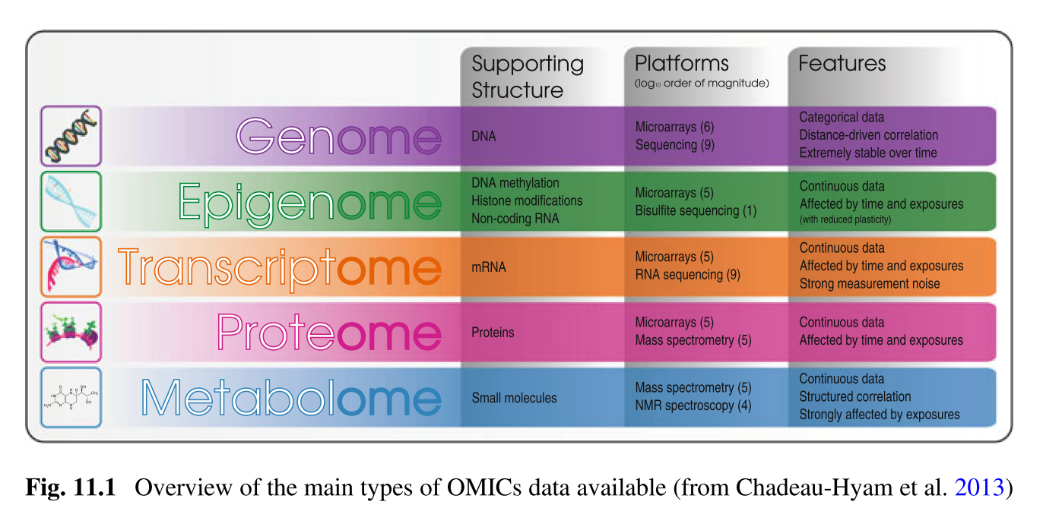

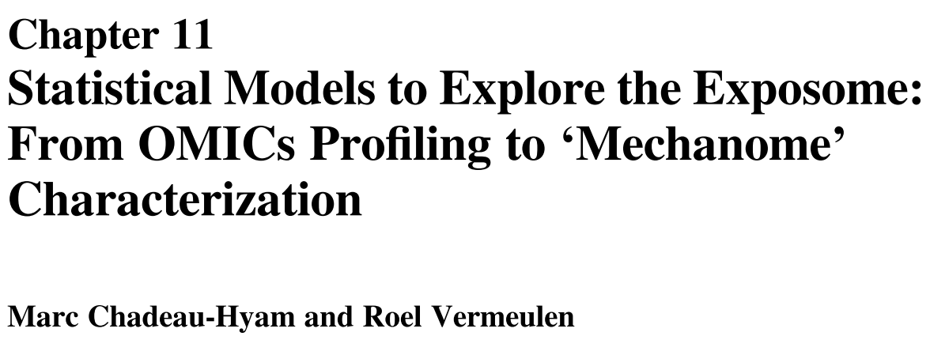
Exploring the exposome
Key issues and approaches to analysis
Key issues from the statistical standpoint
Numerous and highly correlated exposures / exposome components
Heterogeneity of populations and exposures / exposome components
Test multiplicity and false positives
OMICS data are heterogeneous in terms of their…
  1. Dimension: From tens to millions of features being measured
  2. Nature: OMICs data are either binary, categorical, counts, or continuous.
  3. Complexity: Both the intensity and the complexity of the correlation patterns between features assayed within single OMICs can be simply distance-driven, or involve distant and multivariate correlations.
  4. Stability/volatility: OMICs data do not respond with the same intensity and dynamics to external stresses.
Notes:
HELIX

Slide 22
Exploring the exposome
Key issues and approaches to analysis
Key approaches to link exposome to health outcomes / diseases
Agnostic exposure-wide association study (ExWAS) approaches
  Univariate approaches assessing separately the association between each variable (exposures or OMICs data) and the outcome of interest.
  These are coupled with multiple testing correction strategies.
Dimensionality reduction
  Dimensionality reduction techniques building upon the correlation within the data to construct a summary of lower dimension at the cost of a minimal loss of information.
Variable selection techniques
  Variable selection techniques assuming that not all predictors are relevant to the outcome of interest and seek for a sparse subset of predictors mostly related to the outcome.
Clustering techniques
  To identify sub-groups of subjects sharing common exposure patterns and/or disease features and evolution
Causal inference modeling
  To test the statistical validity of specific causal relationships between exposures / disease outcomes
Notes:
HELIX

Slide 23
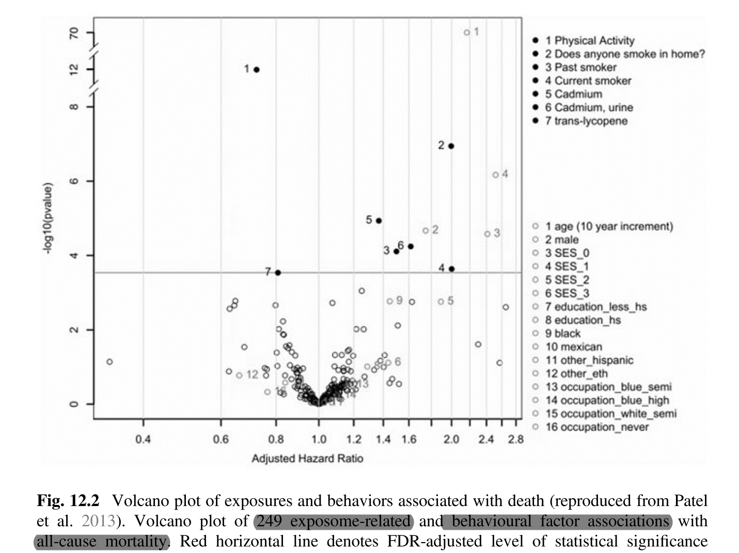
Exposome-wide associations studies general approach
Notes:
Exemple + ex COVID

Slide 24

Task 2.4: Exposome-phenotype associations
Leader: Torkjel M Sandanger; Contributors INSERM, LISA, all cohort partners + DMI
Start date: M30 End date: M48
Aims:
To evaluate the associations between internal/external exposome components and :
  Disease severity or outcomes (e.g. GOLD criteria for COPD, yearly number of acute exacerbations, faster decline in lung function etc.).
  CF/COPD phenotypic clusters ([patient profiles] and [lung decline trajectories])
To prioritize candidate exposome components showing promising correlations with COPD/CF severity/course and lung function evolution
To guide the conduct of WP4 (preclinical models), and WP5 (global risk assessment)
Analyses will notably rely on:
Comparison tests and multilevel analyses using mixed effects (fixed/random) regression models
Data on atmospheric pollution will be assessed as raw, or transformed with filters (e.g. Fourier transform function) to isolate low and high frequency (ie seasonal or imported, and local or punctual) of the exposure.
Correction for test multiplicity to account for the high number of exposome components, using an exposome-wide association study (EWAS) framework

Slide 25
ExWAS exposome-wide association studies
Exposome-wide association studies (ExWAS)
  Allow the discovery of new exposures
  Agnostic and systematic assessment of numerous environmental factors to avoid a fragmented literature of associations
  Explicit estimation of false positive ﬁndings
  Emerging associations can be prioritized to be investigated in biological experiments
Analytical challenges
  Observational studies prone to biases such as confounding and reverse causality
  Multiple signiﬁcant associations with small effect sizes
Patel et al. 2010, 2012, 2013; McGinnis et al. 2016
Notes:
EWAS
+ autres techniques : A systematic comparison of statistical methods to detect interactions in exposome-health associations
Jose Barrera-Gómez ¹ ² ³, Lydiane Agier ⁴, Lützen Portengen ⁵, Marc Chadeau-Hyam ⁶,
the Genome-Wide Association Study (GWAS) is a low-cost, commoditized, and popular frame-work used by researchers to evaluate genetic factors in disease or phenotype along the entirety of the genome (Visscher et al. 2012; Hindorff et al. 2009).

Slide 26
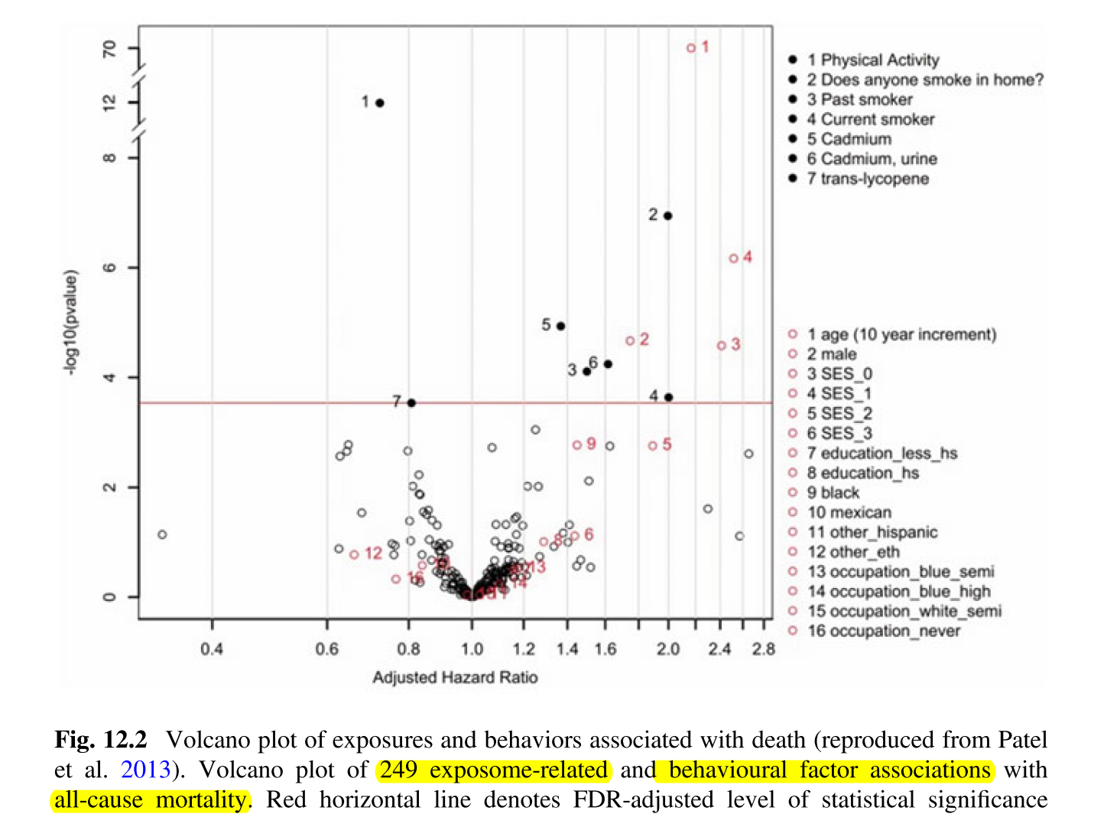
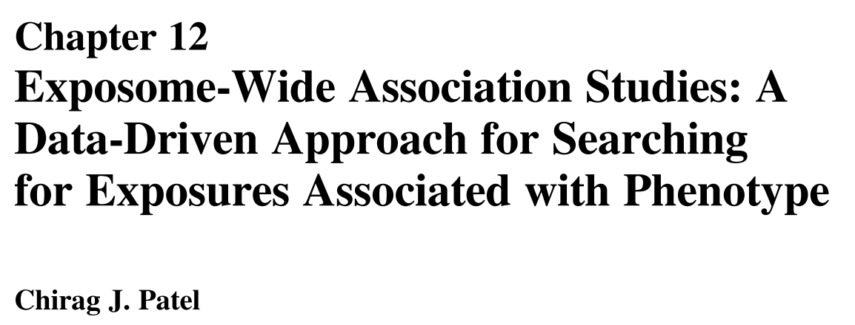
ExWAS exposome-wide association studies
Stage 1: Linear Modeling
Each environmental factor is associated with a phenotype of interest using general linear models, e.g. using logistic regression on cases/controls, possibly adjusting for important covariates.
Stage 2: Controlling for Multiple Hypotheses by Estimating the False Discovery Rate
Given a set of “discoveries”, or a list of potentially signiﬁcant factors, how can we deem those that are false discoveries? In contrast to the Bonferroni correction, the False Discovery Rate (FDR) provides a quantitative estimate of the number of false positives in a set of “ discoveries. ” The FDR is less conservative and therefore more powerful than the Bonferroni correction.
Stage 3: Validation
Findings deemed signiﬁcant corresponding to some nominal FDR level are validated or replicated in one or more additional independent cohorts with a nominal p-value (e.g., p < 0.05 in the independent replication cohort).
Stage 4: Sensitivity Analyses
To test the robustness of the results under varying conditions, given the risk of confounding and reverse causality.
Notes:
EWAS
+ autres techniques : A systematic comparison of statistical methods to detect interactions in exposome-health associations
Jose Barrera-Gómez ¹ ² ³, Lydiane Agier ⁴, Lützen Portengen ⁵, Marc Chadeau-Hyam ⁶,

Slide 27
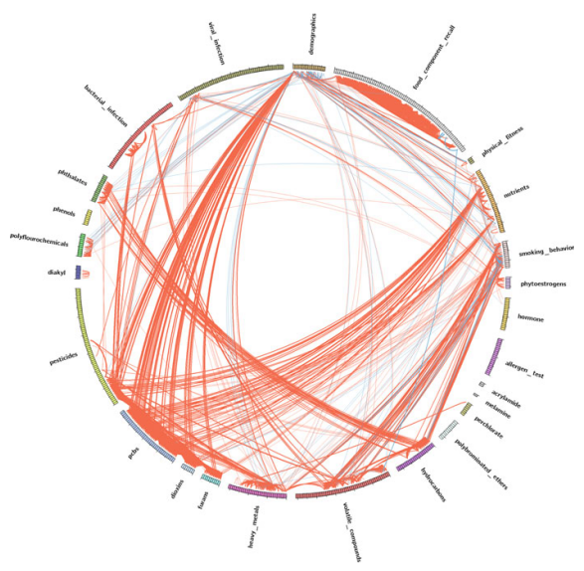
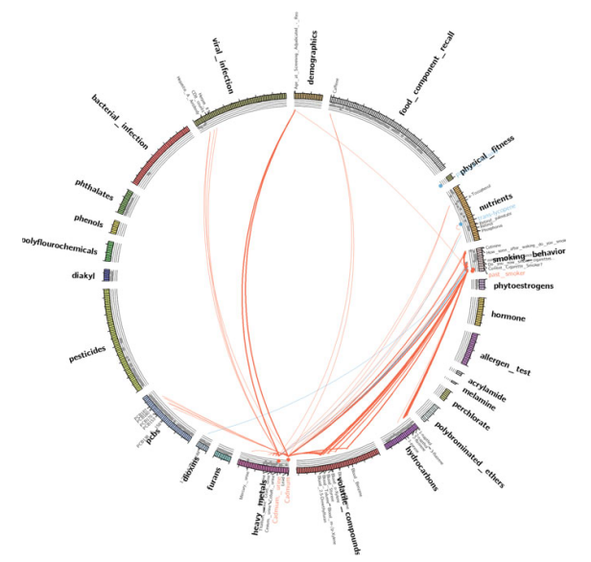
ExWAS exposome-wide association studies
Stage 5: Correlation Globes
Correlation or exposome globes can be used to visualize clusters of exposures correlated with exposures identiﬁed in ExWAS, allowing a broader and more interpretable view of EWAS-identiﬁed exposures.
Notes:
EWAS
+ autres techniques : A systematic comparison of statistical methods to detect interactions in exposome-health associations
Jose Barrera-Gómez ¹ ² ³, Lydiane Agier ⁴, Lützen Portengen ⁵, Marc Chadeau-Hyam ⁶,

Slide 28
ExWAS – extensions
The ExWAS screening method considers each environmental factor in a separate linear model iteratively
Allows screening of many variables while not overﬁtting the linear model
But falsely assumes independence between environmental factors.
Extensions
Feature selection methods: statistical learning such as “shrinkage” methods, enabling to model the dependent variables simultaneously.
Ex: LASSO, elastic net, potentially combined with k-fold cross-validation procedures to select features that have the lowest prediction variability
Methods accounting for interactions between factors:
two-step Environment-Wide Association Study (EWAS2), Deletion/Substitution/Addition (DSA) algorithm, Least Absolute Shrinkage and Selection Operator (LASSO), Group-Lasso INTERaction-NET (GLINTERNET), three-step method based on regression trees, Boosted Regression Trees (BRT)
A systematic comparison of statistical methods to detect interactions in exposome-health associations
Jose Barrera-Gómez ¹ ² ³, Lydiane Agier ⁴, Lützen Portengen ⁵, Marc Chadeau-Hyam ⁶,
Notes:
EWAS
+ autres techniques

Slide 29
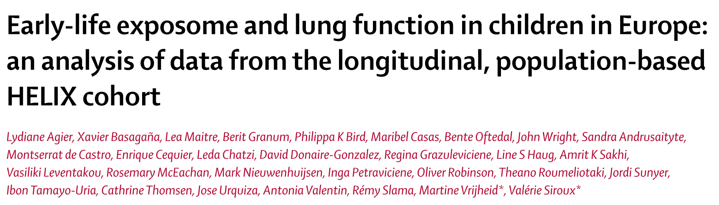
  Example ExWAS
  The HELIX project
« DSA is an iterative linear regression model search algorithm, allowing at each iteration the removal of a term, substitution of one term for another, or addition of a term to the model. The final model is selected by minimising the value of the root-mean-squared error of predictions using five-fold cross-validated data. To stabilise estimates, the DSA was fitted 100 times on the data, and exposures were retained if they were selected in at least 5% of the runs. We repeated the DSA estimation testing for two-way interactions.
The ExWAS consisted of a covariate-by-covariate estimation of the exposure–outcome association by independent linear regression models. For each exposure variable, results from the 20 imputed datasets were aggregated using Rubin’s rules for multiple imputed data such that a unique p value was obtained.
To correct for multiple hypothesis testing, each p value was compared with a threshold, defined as 0·05 divided by the effective number of tests, which estimates the number of truly independent tests that are done given the correlation structure of p values (46·5 and 70·8 effective numbers of tests for the prenatal and postnatal exposome, respectively).
To account for potential co-exposure confounding, we further included in a multivariable linear regression (MLR) model all the exposure variables associated with FEV₁% with a p value of less than 0·20.
In previous simulation studies, DSA had better model selection efficiency than several other regression-based methods in an exposome context similar to ours, mainly in terms of the false-positive rate (28%). However, the complementary ExWAS approach allowed an improved sensitivity (96% for ExWAS vs 73% for DSA), at the cost of a higher false-positive rate (86%).”
Notes:
DSA algorithm
The Deletion/Substitution/Addition (DSA) algorithm
is an iterative process that starts with an empty model and
uses deletion (removing a variable from the model), sub-
stitution (replacing a variable in the model by another not
in the model) or addition (adding a variable in the model)
moves to find the final model (further details are shown in
Additional file 1: Section D). The final model is selected
by minimizing the residual mean squared error (RMSE)
using 5-fold cross-validation.

Slide 30
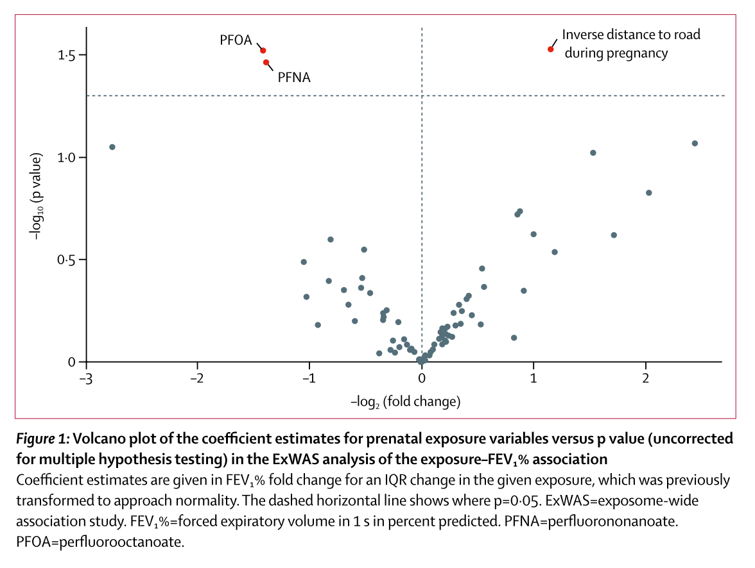
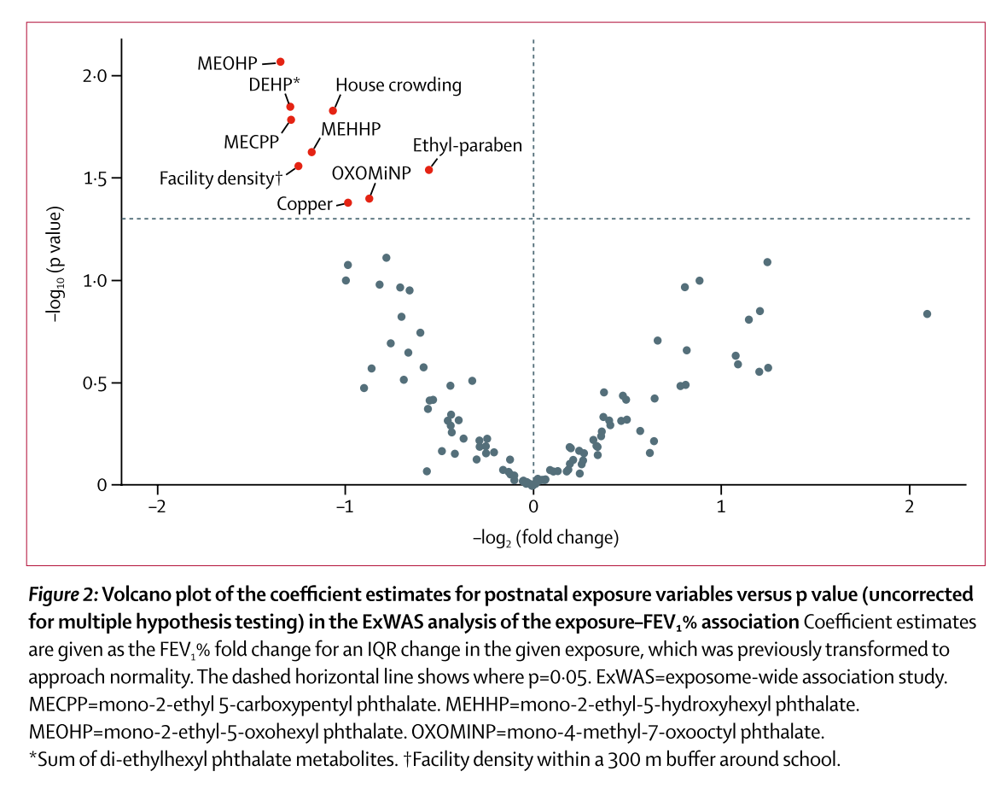
  Example ExWAS
  The HELIX project
Early-life exposome and lung function in children in Europe: an analysis of data from the longitudinal, population-based HELIX cohort. Lydiane Agier et al. Lancet Planet Health 2019; 3: e81–92

Slide 31
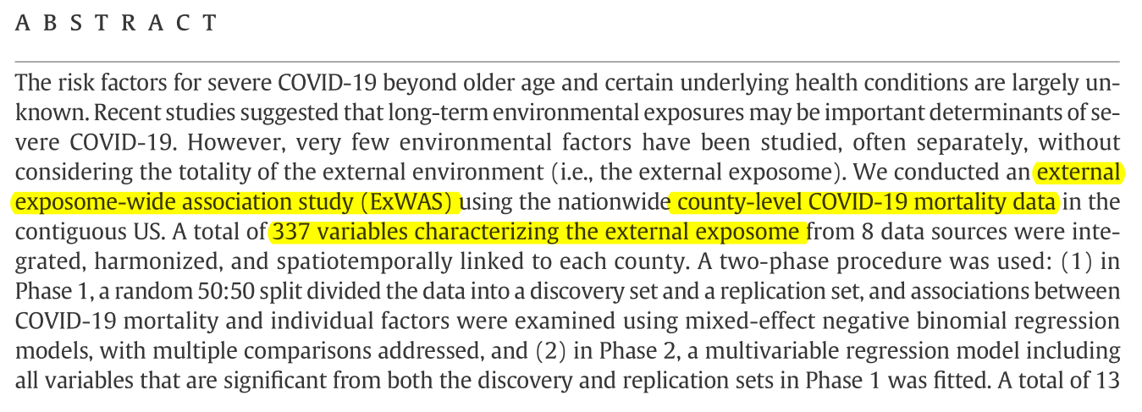
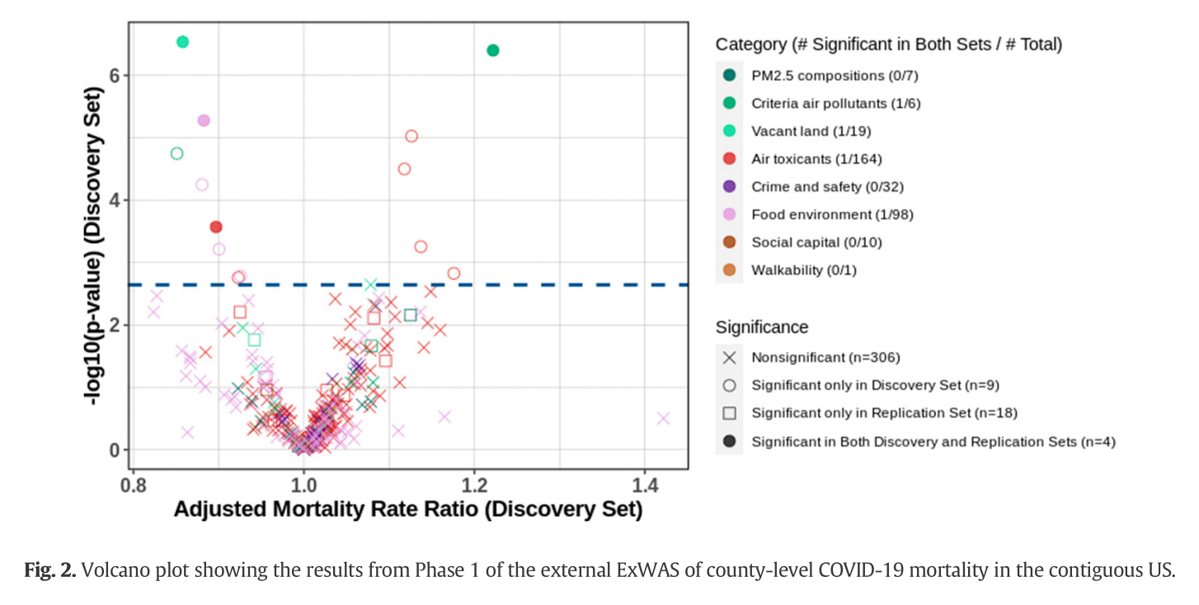
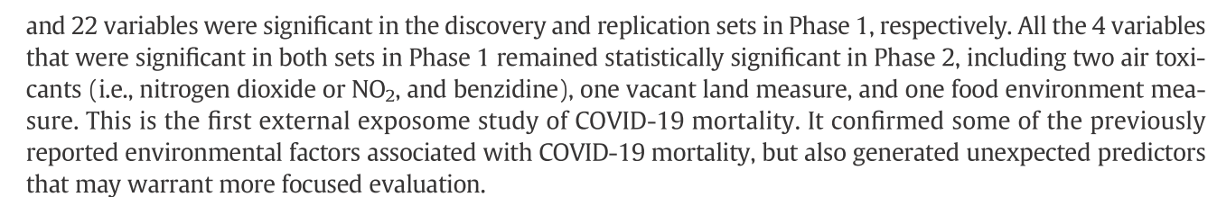
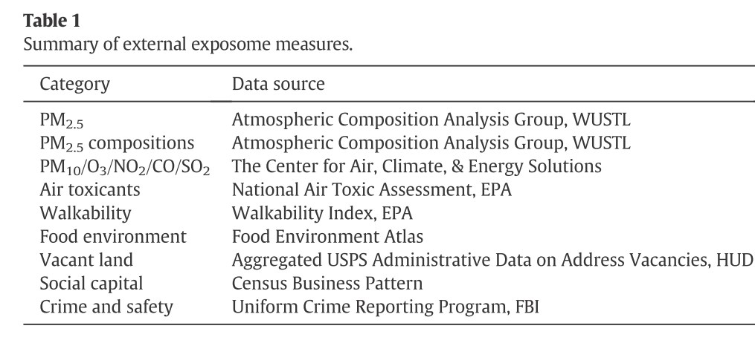
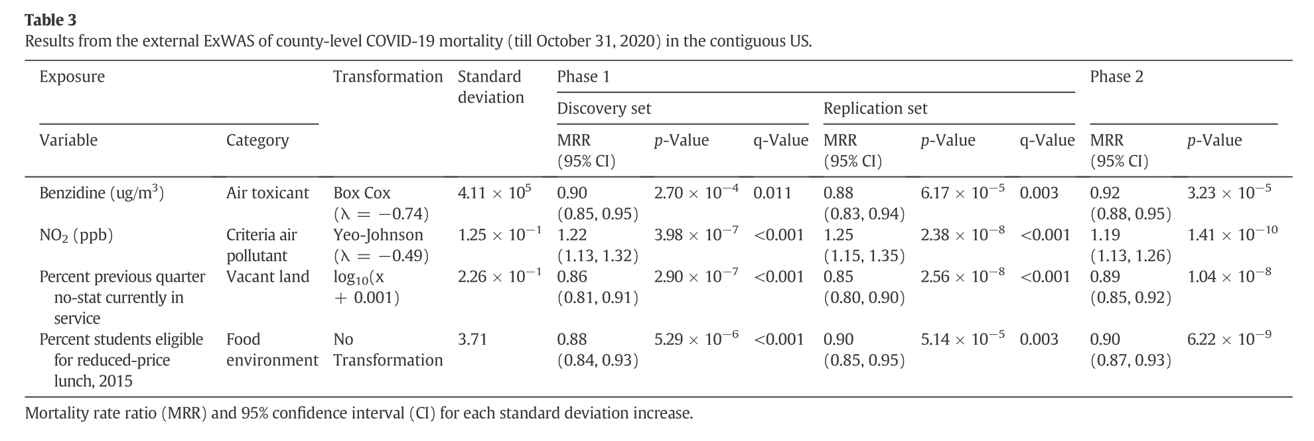
  Example ExWAS (2)
  COVID-19
An external exposome-wide association study of COVID-19 mortality in the United States.
Hu et al. Science of the Total Environment 768 (2021) 144832

Slide 32
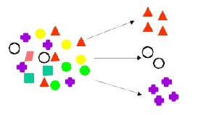
Clustering

Slide 33
Task 2.3: Descriptive analyses and phenotypic characterization
Task 2.4: Exposome-phenotype associations
Leader: INSERM 1.B; Contributors: LISA, all cohort partners + DMI
Start date: M12 End date: M36
Two main research questions
Is there specific exposome(s) associated with particular COPD or CF phenotypes? Does similar exposome impact COPD and CF the same?
Is there specific exposome(s) linked to lung function trajectories and maximal achieved lung function at early adulthood (taken as an early determinant of COPD and CF outcome)?
Clustering approaches
Phenotypic clustering
  Unsupervised clustering algorithms to identify phenotypic clusters based on disease severity/outcomes/exposome in CF/COPD patients
Lung function trajectories
  Dynamic clustering based on longitudinal data to identify typical trajectories in lung function evolution over time
  Either considering early life period until reaching maximal achieved lung function,
  or considering lung decline in COPD/CF patients.

Slide 34
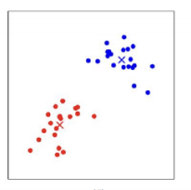
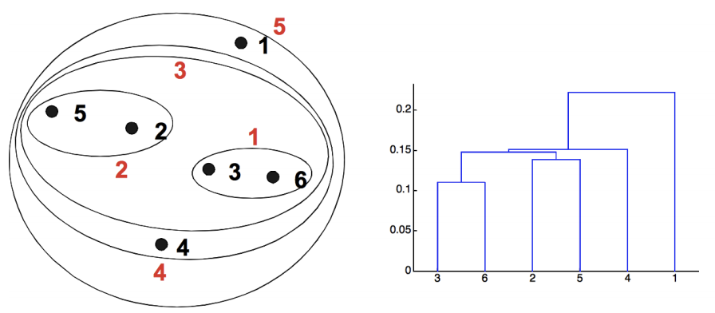
Clustering
Multiple clustering methods have been developped, e.g.
Partitioning: k-means
Hierarchical methods: ascending and descending
Density-based methods (DBSCAN)
Model-based methods (mixture models, latent classes approaches)
All methods must face similar difficulties and challenges
Handling of different data types / formats: binary, multicategorical, continuous, ... ?
Defining « similarity » between observations ?
Defining clusters boundaries ?
Assessing clusters validity and optimal number ?
Interpretating findings and clinical relevance of the identified subgroups ?

Slide 35
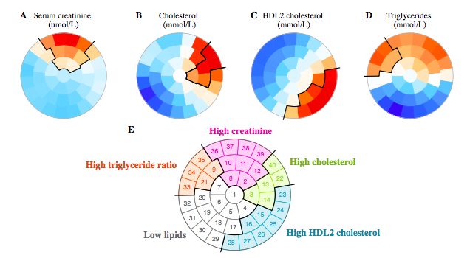
Self-Organizing Maps (SOMs)
Illustrative Exemple
Clustering approach allowing the building of 2D- maps, where subjects are placed according to their characteristics
  Similar subjects in close proximity
  Distinct subjects in remote locations
Subjects are always located at the same location within each map (1 map / characteristic)
Values in ‘red’ indicate the highest values / Lowest values are in ‘blue’
This approach allows visual comparisons, useful to determine clinically relevant clusters
Highest Creatinine
values
Lowest créatinine values

Slide 36
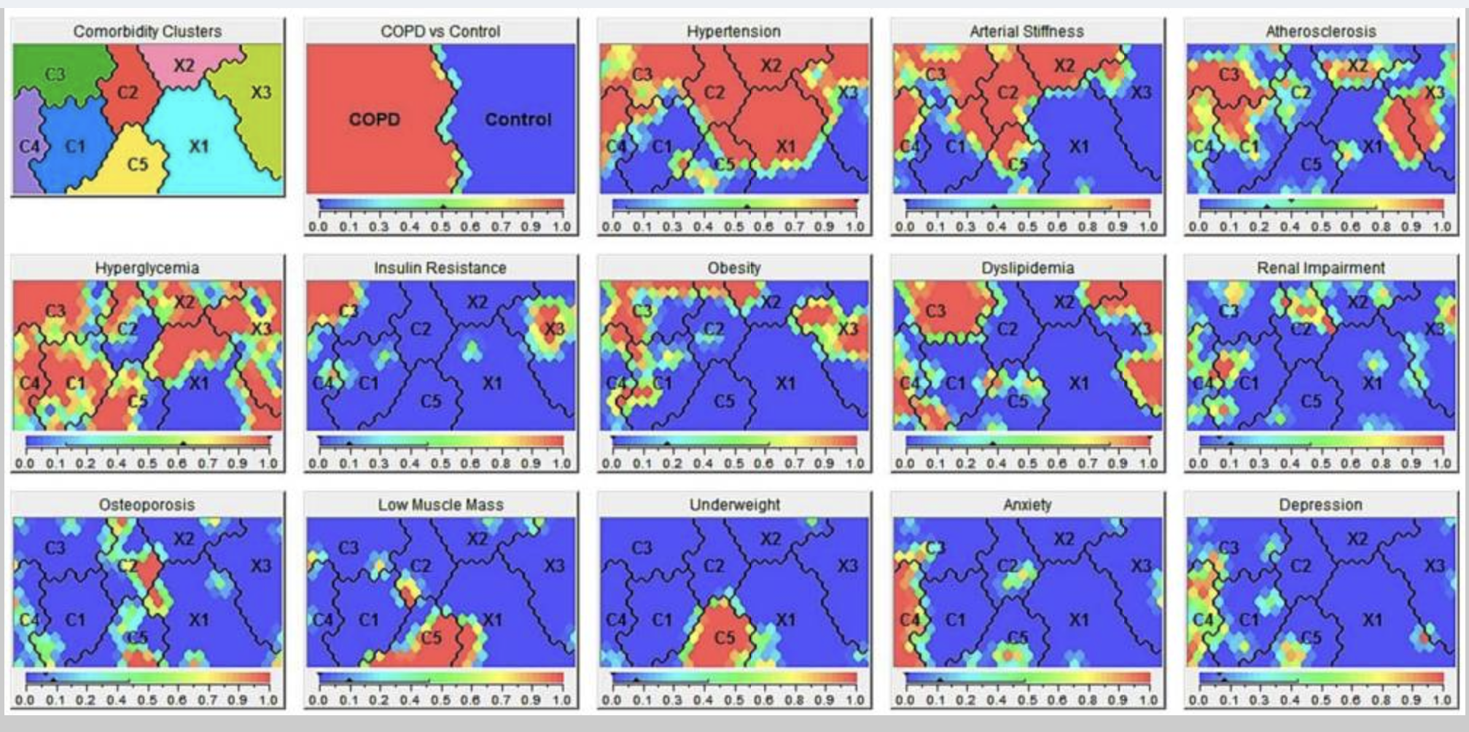
  Example
  SOMs
Disease-Specific Comorbidity Clusters in COPD and Accelerated Aging
Triest et al. J Clin Med. 2019 Apr; 8(4): 511
(Co)morbidity clusters in COPD and controls.

Slide 37
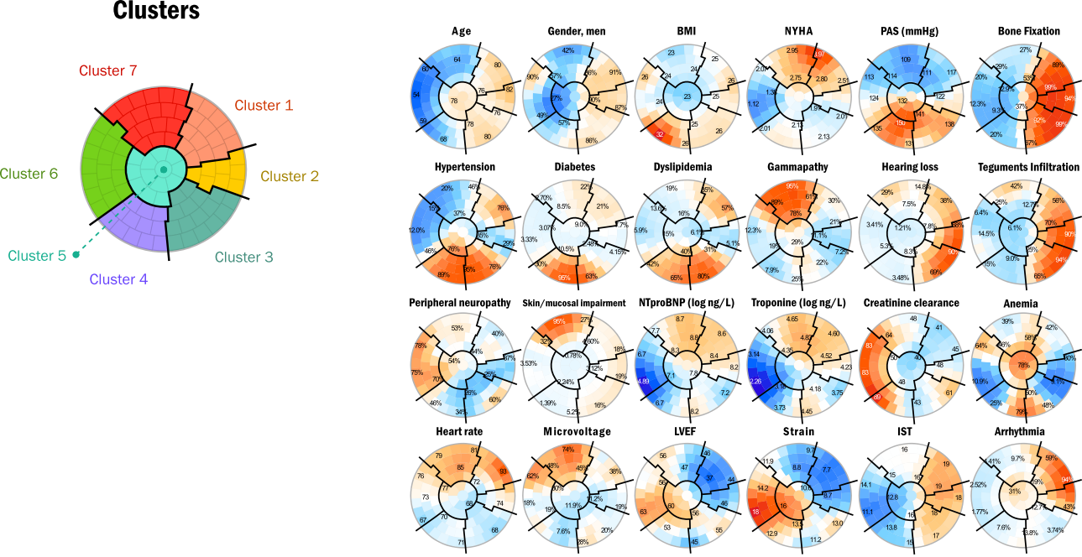
  Example
  Phenotypic characterization by SOMs

