Slide 1
WP3 - Sensor Toolkit presented by
30/09/2021

Slide 2
WP3 Objectives for period 1
O3.1: Develop a first prototype of the environment toolbox for relevant environmental air pollutants and start to miniaturize the System.
O3.2: Develop a biosensor platform for human exhaled air (exhalat).

Slide 3
WP3 achievements
Task 3.1: Development of an environment toolbox (M01-36)
Leader: P09-FhG-ITEM, Contributors: P09-FhG Institutes
Literature was reviewed
Several sensors were tested that met the requirements of the literature. First electronic prototype is under test (M13). Due to covid-19 there is currently a delay of approx. 5 months which is not seen as critical
Sensors have been calibrated.
Gas | CO | VOC | NO2 | O3 | PM | Temperature | Humidity | So2
Sensor Option 1 | MiCS-6814 | CCS811 | MiCS-6814 | Winsen MQ131 | SPS30 | BME280 | BME280 | Winsen ME3-SO2
Sensor Option 2 | Winsen ZE07-CO | SGP30 | NO2-B43F | Winsen ZE14-03 | SDS011 | - | - | 110-602
Sensor Option 3 | TB200B-ES1-CO-10 | - | TB200B-ES1-NO2-5 | TB200B-ES1-O3-5 | - | - | - | TB200B-ES1-SO2-5
Chosen sensors
Sensor did not perform properly
The sensor has been successfully tested, but has some weak points
Gas | Remedia requirements | Chosen sensor range | Chosen sensor resolution
Co | 0.1-10 ppm | 0-10 ppm | 0.001 ppm
O3 | 1-100 ppb | 0-5 ppm | 0.001 ppm
So2 | 1-50 ppb | 0-5 ppm | 0.01 ppm
No2 | 1-500 ppb | 0-5 ppm | 0.01 ppm
VOC | 1 – 200 µg/m³ | eCO2: 400 ppm – 29206 ppm eTVOC: 0 ppb – 32768 ppb | -
PM10 | 1-200 µg/m³ | 1-1000 µg/m³ | ±1.25 µg/m³
PM2.5 | 1-100 µg/m³ | 1-1000 µg/m³ | ±1.25 µg/m³
Temperature | 5- 45°C | -40 – 85°C | 0.01 °C
Humidity | 0 -100% | 0 -100% | 1%

Slide 4
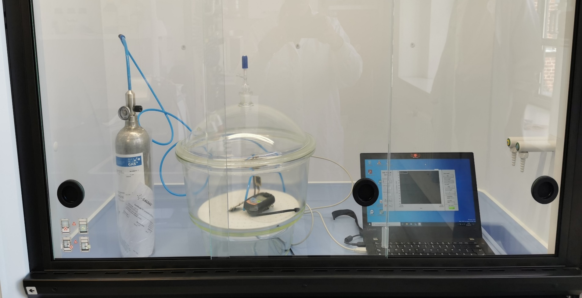
WP3 achievements
Task 3.1: Development of an environment toolbox (M01-36)
Leader: P09-FhG-ITEM, Contributors: P09-FhG Institutes
A procedure for sensors calibration using an external measuring device was worked out.
Miniaturization:
Final software, PCB design, mechanical concept are in progress

Slide 5
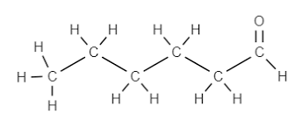
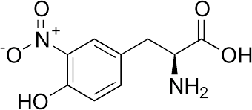
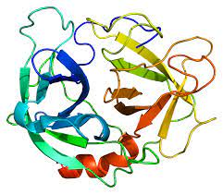
WP3 achievements
Task 3.2: Development of a biomarker toolbox (M01-M48)
Lead: P09-FhG-ICT, Contributors: P09-FhG Institutes, P11-KUL
Based on internal knowledge and literature search, biomarkers for detection in EBC (=exhaled breath condensate) have been selected:
Biomarker (Sensor) | Healthy | COPD | CF | Ref.
Hexanal (MIP) | 14.2 ± 3.5 nM | 63.5 ± 4.4 nM | - | Corradi et al. (2003)
Nitrotyrosine (MIP + aptamer) | 3.5 ± 2.9 nM | 5.5 ± 2.4 nM | 111.8 ± 6.6 nM | Lee et al. (2014) Balint et al. (2001)
Neutrophil elastase (Aptamer) | 61.0 pM | - | 132.2 pM | Fila et al. (2008)

Slide 6
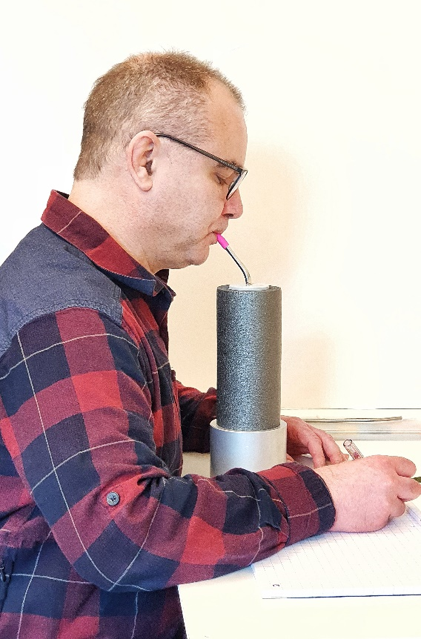
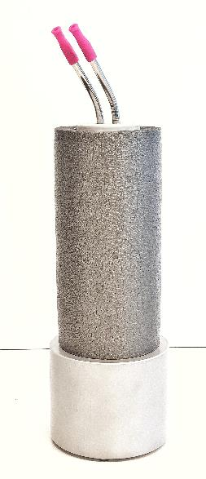
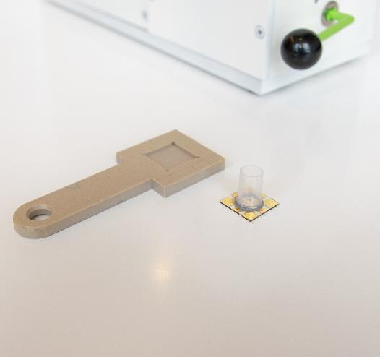
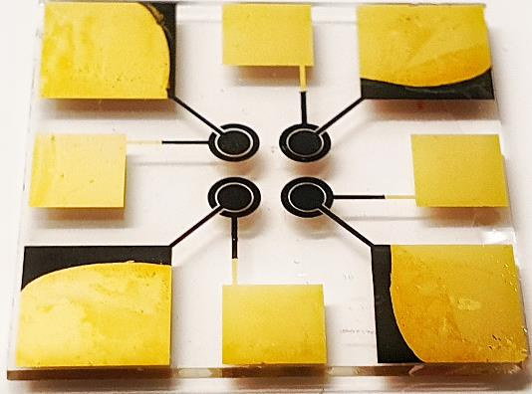
WP3 achievements
Task 3.2: Development of a biomarker toolbox (M01-M48)
Lead: P09-FhG-ICT, Contributors: P09-FhG Institutes, P11-KUL
Selective coatings for the sensors and coating technique has been developed (ICT, KUL)
Transfer to the impedance sensors at KUL started in M19.
For Nitrotyrosine and Neutrophil elastase (redundancy) aptamers are under development at FhG IZI-BB.
Instrumentation:
A sterilizable condensation tool to collect 2 mL EBC per sample is available (KUL)
Biosensing chips with four sensing spots for three different biomarkers plus a reference electrode ready (KUL)
Prototype of measuring device ready to use

Slide 7
WP3
WP3 deliverables
No deliverables in period 1

Slide 8
WP3
WP3 Milestones
N° | Milestone name | WP | due date (DoA) | Partners | Actual / Forecast delivery date (day/month/year) | Status (achieved/ not achieved) | Comments Report 1
MS6 | Environment Toolbox specification | 3 | 14 | P09 FhG |  | Yes
MS8 | Biomarker toolbox for exhaled air(healthy volunteers) | 3 | 18 | P09 FhG | 21 | No | there will be a delay of 3 months for this Milestone, due to sanitary measures of COVID-19 pandemic, but the overall workplan will not be impacted

Slide 9
WP3 Management
Decisions/actions to be taken within the next months:
Development of an integrated sensor device (M43-M60)
It needs to be considered that the two systems assess processes, which happen on different time scales:
The environmental sensor will need to monitor the exposure or the exposome in as much detail as possible to include changes in the environment due to the mobility of a subject
The inflammatory response of the airways due to these environmental exposures is related to the cumulative concentrations of pollutants and potentially also to peak concentrations.
Airway inflammation on the other hand is changing on rather longer scales. From experimental ozone exposures FhG-ITEM has evidence that first slight increases in markers can be observed starting 1-2 h after acute exposure of 3 h of ozone.
Its also known from chronic diseases like asthma, that the diurnal variation of airway inflammation has 2 peaks over 24 h, also indicating a longer time scale.
Taken together it should be sufficient to assess airway inflammation once per day.

Slide 10
WP3 Management
Decisions/actions to be taken within the next months:
Development of an integrated sensor device (M43-M60)
The environmental sensor can often take data and be a small device. The actual environmental conditions will be monitored with high resolution
The biosensor will be much larger and have a lower measurement rate
→ Both the measuring device size and the measuring rate of both devices must be different
Miniaturization of the environmental Sensor will be conducted as planned
Sample collection for the biomarker sensor will be conducted by the volunteers themselves (straw)
→ Separating the sensors is in no contradiction to the goal of Task 3.3.
Miniaturization of the environmental Sensor will be conducted as planned,
Sample collection for the biomarker sensor will also be possible by the volunteers themselves
The only difference is, that for reasons of practicability the biosensor detection unit will be operated separately from the environmental sensor

Slide 11
WP3 Scientific Management
Meetings organised:
Besides regularly ExCom Calls (9), regularly Work Package update meetings every 1 to 2 month
Meetings to come:
Update meeting October 21
Ongoing collaborations /connections to other WPs:
WP2 (Data integration and exposome-phenotype associations): Possibly adoption to biomarkers relevant for COPD & CF

Slide 12
WP3 Outlook: Objectives for period 2
O3.2: Develop a biosensor platform for human exhaled air (exhalat), continued.
Proof of concept in healthy volunteers (measuring the agreed molecules) Performance of the biomarker toolbox will be validated against common assays (gold standard, M23).
adapt the biomarker toolbox to biomarkers relevant to COPD or CF patients (M48)
O3.4 Show correlation of biosensor signal with environmental sensor system in a clinical challenge setting (M48 – M60)

Slide 13
WP3 Outlook: Workplan period 2
 |  |  |  |  | 2020 |  |  |  |  |  |  |  |  |  |  |  | 2021 |  |  |  |  |  |  |  |  |  |  |  | 2022 |  |  |  |  |  |  |  |  |  |  |  | 2023 |  |  |  |  |  |  |  |  |  |  |  | 2024
WP3 : Sensor Toolkit
Task 3.1: Development of an environment toolbox | First Prototype |  |  |  |  |  |  |  |  |  |  |  |  |  | Calibrating and testing |  |  | Sensor Selection |  | Hardware Integration |  |  | Firmware Integration |  |  | Miniature System |  |  |  |  |  | Final system validation
Task 3.2: Development of a biomarker toolbox | Spec. Sheet |  |  |  |  | System w. best performance (MIPS/Aptamers- on dif. Sensors) |  |  |  |  |  |  |  |  |  |  |  |  | Healthy Volunteers |  |  |  |  |  | Sensor adapt. for spec. req. of COPD-exhalat biomol. |  |  |  |  |  |  |  |  |  |  |  | Lab. Verification
Task 3.3: Development of an integrated sensor device |  |  |  |  |  |  |  |  |  |  |  |  |  |  |  |  |  |  |  |  |  |  |  |  |  |  |  |  |  |  |  |  |  |  |  |  |  |  |  |  |  |  | Provision of a sufficient number of devices |  |  |  |  |  | Clinical challenge Study in COPD (ITEM) /CF (CHIC)

Slide 14
WP3 Other issues
Questions for advice from WP to reviewers

