Slide 1
WP4 - Simulation of exposome in preclinical models presented by
30/09/2021

Slide 2

WP4 Objectives for period 1
Generate representative atmospheres, especially in term of micropollutants (PM, VOC, Nox, O₃, …)
Generate at the laboratory complex representative atmospheres of selected cities
• Make these atmospheres flow through the preclinical model’s exposure devices
• Characterize the resultant atmosphere inside these exposure devices, that means:
- qualify/quantify the gaseous pollutants present
- qualify/quantify the aerosols present
• Establish if the simulated atmosphere to which the preclinical models are exposed to are complex, in the sense of just as complex as real city atmospheres.

Slide 3
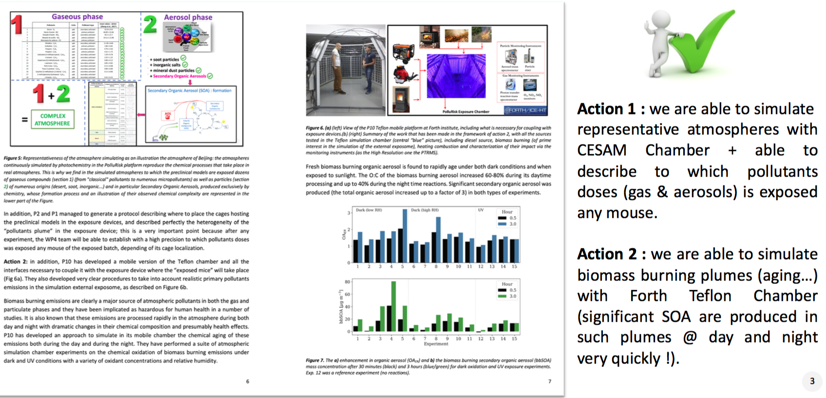

WP4 achievements
Task 4.1: Generation and characterization of complex representative atmosphere(s) (M01-M36 ) Leader: P02-LISA, Contributors: P10-FORTH

Slide 4
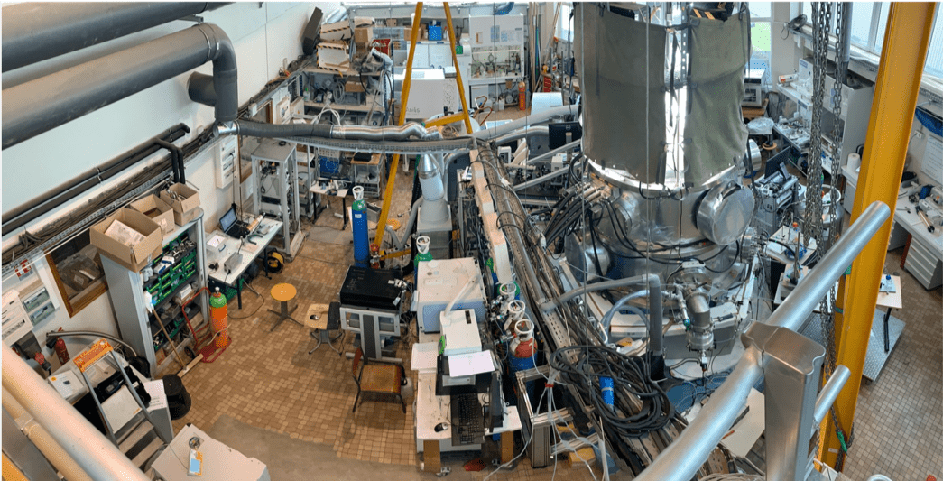
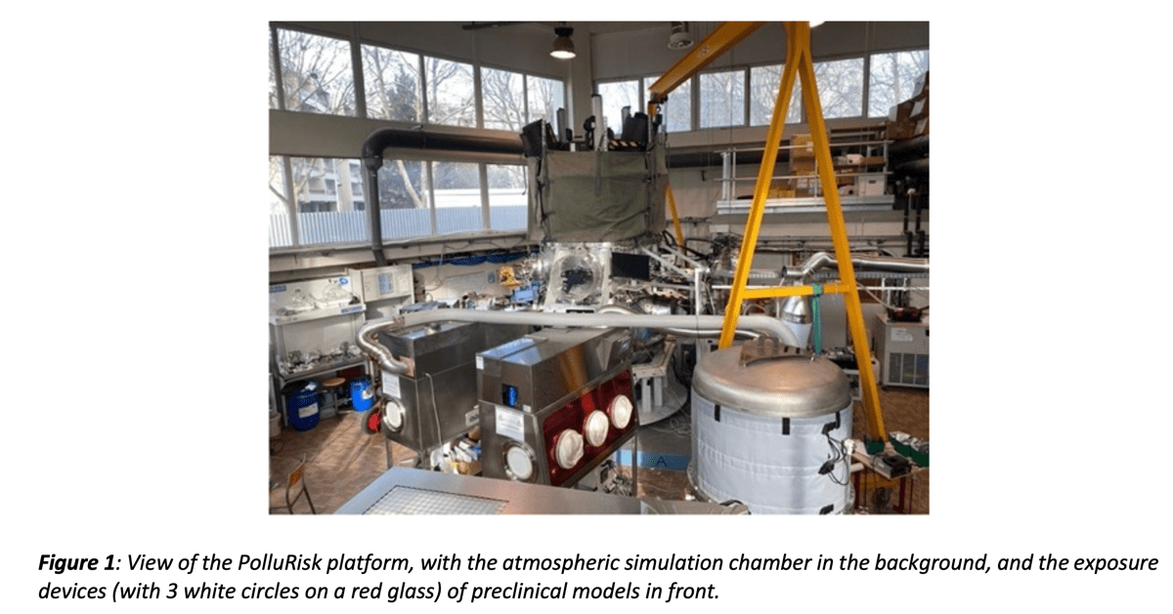
WP4 achievements

Slide 5
WP4 achievements
Task 4.2: Implementation of more complex simulated external exposome (M24-M42)
Leader: P01-INSERM, Contributors: P02-LISA, P10-FORTH
Ahead of schedule
Implementation experimental phase Start => meeting in person at Forth (Greece) in October involving the 3 partners (to prepare the future coupling of our 2 chambers).
Data treatment and valorization of acquired data (including calibration experiments) under progress.

Slide 6
WP4 achievements
Task 4.3: Exposure of preclinical models (naïve, COPD and Cystic Fibrosis) (M24-M60) Leader: P02-LISA, Contributors: P01-INSERM
Ahead of schedule
CF mice exposed to Beijing-type atmosphere present more mucus (a sign of inflammatory response) than those exposed to filtered air.
➔ Accuracy of the experimental set-up
.

Slide 7
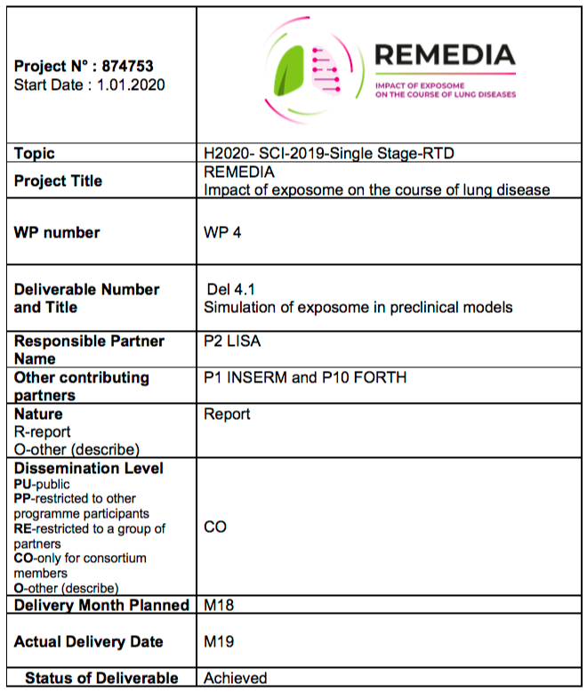

WP4
WP4 deliverables
Nber | Title | WP | Partners | Type | Dissemination level | Date Delivery
D4.1 | Atmosphere type | WP4 | P02-LISA | DEM | CO | 18

Slide 8
WP4
WP4 Milestones
N° | Titel Milestone | WP | due date (DoA) | Partners | Actual / Forecast delivery date (day/month/year) | Status (achieved/ not achieved) | Comments Report 1
MS12 | Choice of targeted atmospheres | 4 | 8 | P02 LISA | 8 | delayed | delayed of 6 months due to delay in WP2 M24

Slide 9
WP4 Management
Hurdles and bottlenecks:
Nothing specific
Decisions/actions to be taken within the next months:
Choice of more complex atmospheres?
….

Slide 10
WP4 Scientific Management
Meetings organised:
#WP4 monthly meetings (organized on a monthly basis April 2020 => July 2021)
Meetings to come:
#WP4 in person – october 2021 (Greece)
#WP4 monthly meetings – November and upcoming months
Ongoing collaborations /connections to other WPs:
#WP2: following WP2 developments, exchanges around potential components of the exposome to take into account
#WP3: following WP3 developments, in case of WP4 members may help Sensor evaluation or developments.

Slide 11
WP4 Outlook: Objectives for period 2
Exposome elements (identified in WP#2) implementation in the simulations
Exposure of preclinical models to these simulated complex exposomes

Slide 12
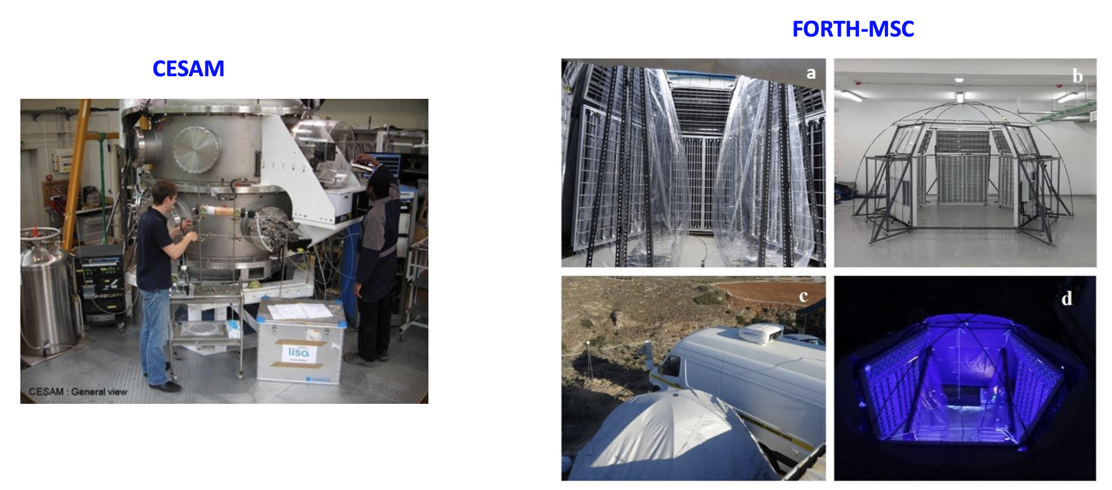
WP4 Outlook: Workplan period 2
Planification/preparation this fall of next campaign (December 2021): atmosphere TBD
(Danish atmosphere ?)
Coupling tests of the 2 simulation chambers at P02-LISA site (2022)

